Slide 1

INTRODUCTION TO DATA SCIENCE
MODULE # 3 : DATA SCIENCE PROCESS
IDS Course Team BITS Pilani

Slide 2
Table of Contents
Confusion Matrix
ROC
1
Introduction to Data Science

Slide 3
Confusion Matrix
A Confusion matrix is a table that is often used to evaluate the performance of a classification model (or “classifier”).
A Confusion Matrix shows what the machine learning algorithm did right and what the algorithm did wrong (misclassification).
It works on a set of test data for which the true values are known. There are two possible predicted classes: “YES” and “NO”.
1
Introduction to Data Science

Slide 4
Confusion Matrix
 |  | Actual Values
Predicted Values |  | Y | N
 | Y | True Positive | False Positive (Type I Error)
 | N | False Negative (Type II Error) | True Negative
1
There are four quadrants in the confusion matrix, which are symbolized as below.
True Positive (TP) : The number of instances that were positive and correctly classified as positive.
False Positive (FP): The number of instances that were negative and incorrectly classified as positive.
This also known as Type 1 Error.
False Negative (FN): The number of instances that were positive and incorrectly classified as negative.
It is also known as Type 2 Error.
True Negative (TN): The number of instances that were negative and correctly classified as negative.
Introduction to Data Science

Slide 5
Confusion Matrix
Which type of misclassification is more serious?? Type-I Error or Type-II Error?
Case I : Predicting whether a convict should be hanged or not? [Type I Error more Serious]
False Positive – Algorithm predicts that the convict has committed the crime, in reality, he is innocent. Verdict: He will be hanged.
False Negative – Algorithm predicts that the convict is innocent, in reality, he has done the crime.
Verdict: He is released.
Case II : Predicting Smog in a region and alerting the public [Type II Error more Serious]
False Positive – Algorithm predicts smog, in reality, there is NO SMOG.
Verdict: People will take precaution unnecessarily.
False Negative – Algorithm predicts NO SMOG, in reality, there is SMOG.
Verdict: The high Smog may cause health issues in the people, since they have not taken precaution.
1
Introduction to Data Science

Slide 6
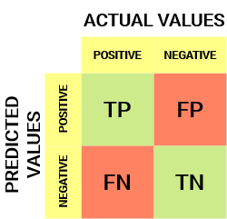
Confusion Matrix
Let us consider an example of model predicting a Tumour for a patient.
Interpretation:
True Positive (TP): Model predicted ‘Tumour’ and the patient has tumour.
False Positive (FP): Model predicted ‘Tumour’, the patient has ‘No Tumour’. This also known as Type 1 Error.
False Negative (FN): Model predicted ‘No Tumour’ but the patient actually has tumour. It is also known as Type 2 Error.
True Negative (TN): Model predicted ‘No Tumour’ and the patient has no tumour.
 |  | Actual Values
Predicted Values |  | Y | N
 | Y | 10 | 22
 | N | 8 | 60
Introduction to Data Science

Slide 7
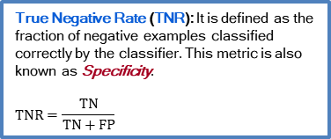
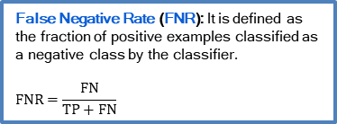
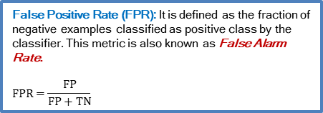
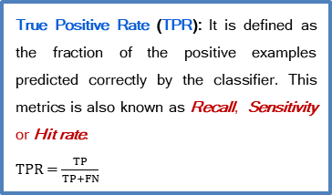
Confusion Matrix
True Positive Rate (TPR): It is defined as the fraction of the positive examples predicted correctly by the classifier. This metrics is also known as Recall, Sensitivity or Hit rate.
$TPR=$ $\frac{TP}{TP+FN}$
False Negative Rate (FNR): It is defined as the fraction of positive examples classified as a negative class by the classifier.
$$FNR=\frac{FN}{TP+FN}$$
False Positive Rate (FPR): It is defined as the fraction of negative examples classified as positive class by the classifier. This metric is also known as False Alarm Rate.
$$FPR=\frac{FP}{FP+TN}$$
True Negative Rate (TNR): It is defined as the fraction of negative examples classified correctly by the classifier. This metric is also known as Specificity.
$$TNR=\frac{TN}{TN+FP}$$
Introduction to Data Science

Slide 8
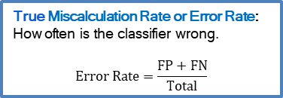
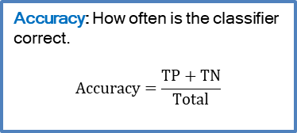
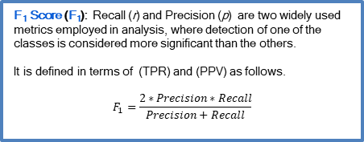
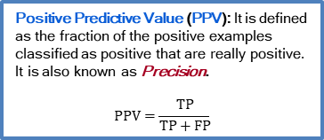
Confusion Matrix
Positive Predictive Value (PPV): It is defined as the fraction of the positive examples classified as positive that are really positive. It is also known as Precision.
$$PPV=\frac{TP}{TP+FP}$$
Accuracy: How often is the classifier correct.
$$Accuracy=\frac{TP+TN}{Total}$$
F₁ Score (F₁): Recall (r) and Precision (p) are two widely used metrics employed in analysis, where detection of one of the classes is considered more significant than the others.
It is defined in terms of (TPR) and (PPV) as follows.
$$F_{1}=\frac{2∗Precision∗Recall}{Precision+Recall}$$
True Miscalculation Rate or Error Rate: How often is the classifier wrong.
$$Error Rate=\frac{FP+FN}{Total}$$
Introduction to Data Science

Slide 9









Formulae
All Formulae
$TPR=$ $\frac{TP}{TP+FN}$
$$FPR=\frac{FP}{FP+TN}$$
$$TNR=\frac{TN}{TN+FP}$$
$$Precision=\frac{TP}{TP+FP}$$
$$F_{1}=\frac{2TP}{2TP+FP+FN}$$
$$Accuracy=\frac{TP+TN}{Total}$$
$$FNR=\frac{FN}{TP+FN}$$
$$Error Rate=\frac{FP+FN}{Total}$$
Introduction to Data Science
Alternative formula for F1 calculation
$$F_{1}=\frac{2∗Precision∗Recall}{Precision+Recall}$$

Slide 10
Case Study – CHF Prediction
Calculate the following metrics for the given confusion matrix:
1. True Positive Rate (TPR) [Recall / Sensitivity]
2. False Positive Rate (FPR)
3. False Negative Rate (FNR)
4. True Negative Rate (TNR) [Specificity]
5. Precision
6. F1 Score
7. Accuracy
8. Error Rate or Miscalculation Rate
 |  | Actual Values
Predicted Values |  | Y | N
 | Y | 100 (TP) | 10 (FP)
 | N | 5 (FN) | 50 (TN)
Introduction to Data Science

Slide 11
Case Study – CHF Prediction
1. True Positive Rate (TPR) [Recall / Sensitivity] = 0.95
2. False Positive Rate (FPR) = 0.17
3. False Negative Rate (FNR) = 0.047
4. True Negative Rate (TNR) [Specificity] = 0.83
5. Precision = 0.91
6. F1 Score = 0.93
7. Accuracy = 150/165 = 0.91
8. Error Rate or Miscalculation Rate = 15/165 = 0.09
 |  | Actual Values
Predicted Values |  | Y | N
 | Y | 100 (TP) | 10 (FP)
 | N | 5 (FN) | 50 (TN)
Introduction to Data Science

Slide 12
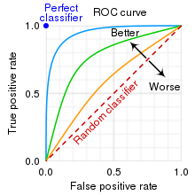
ROC Curve
An ROC curve (receiver operating characteristic curve) is a graph showing the performance of a classification model at all classification thresholds.
It shows the trade-off between Sensitivity and Specificity
ROC curve plots two parameters:
True Positive Rate
False Positive Rate
Scikit-learn’s confusion matrix uses 0.5 as threshold.
https://www.analyticsvidhya.com/blog/2020/06/auc-roc-curve-machine-learning/
https://towardsdatascience.com/understanding-the-roc-curve-in-three-visual-steps-795b1399481c
Introduction to Data Science

Slide 13
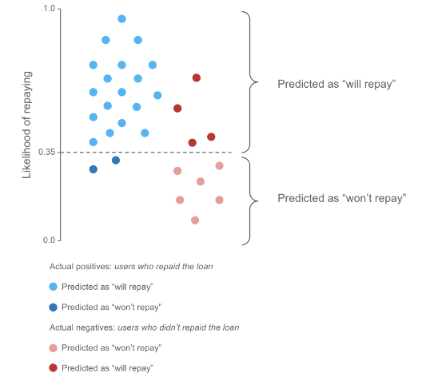
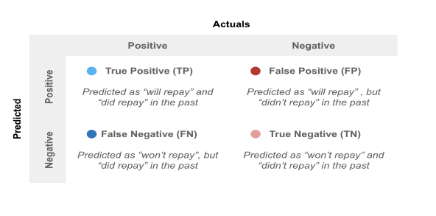
Data points for Likelihood of Repaying a Loan
The probabilities usually range between 0 and 1.
The higher the value, the more likely the person is to repay a loan.
In the example on Fig, we’ve selected a threshold at 0.35:
All predictions at or above this threshold, are classified as “will repay”
All predictions below this threshold, are classified as “won’t repay”
Introduction to Data Science

Slide 14
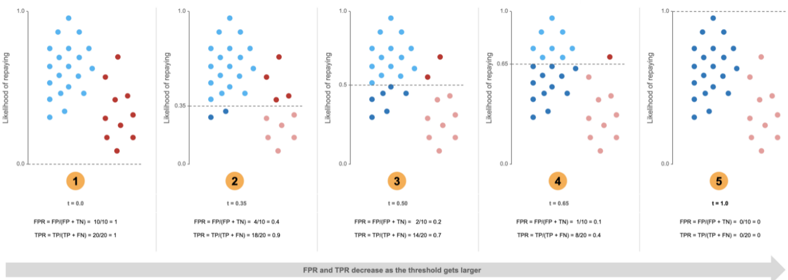
Altering the Threshold values
Altering the threshold to 0, 0.35, 0.5, 0.65 and 1 levels. Notice how the FPR and TPR changes accordingly
Overall, we can see this is a trade-off. As we increase our threshold, we’ll be better at classifying negatives, but this is at the expense of mis-classifying more positives
Introduction to Data Science

Slide 15
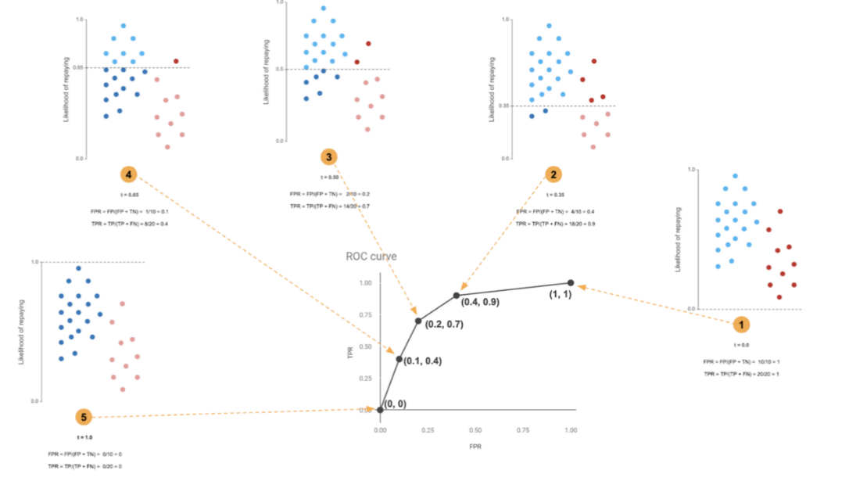
ROC Curves: Plot TPR and FPR for every Cutoff
Area under ROC Curve (AUC)
Introduction to Data Science

Slide 16
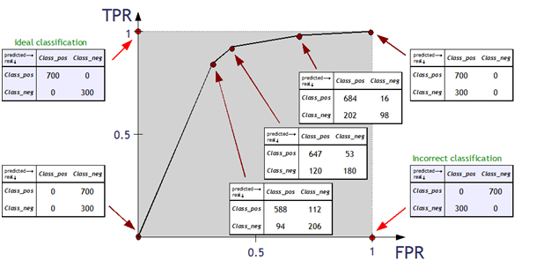
Ideal Classifier - Example
The higher the AUC, the better is the classifier model
Introduction to Data Science

Slide 17
https://www.analyticsvidhya.com/blog/2020/06/auc-roc-curve-machine-learning/
https://towardsdatascience.com/understanding-the-roc-curve-in-three-visual-steps-795b1399481c
THANK YOU
Introduction to Data Science

